Slide 1
GO Team Meeting #2
Where we are – Where we’re going

Slide 2


Where We Are
Our strategic plan is the guide for the work we’re doing in the school. By monitoring the plan and ranking priorities, we can all work towards the common goals. Using the priorities in the strategic plan, the school leadership team developed a Continuous Improvement Plan (CIP) for the current school year.

Slide 3
Timeline for GO Teams
You are HERE
Fall 2021
GO Team Developed 2021-2025 Strategic Plan
1
Summer 2022
School Leadership completed Needs Assessment and defined overarching needs for SY22-23
2
August 2022
School Leadership completed 2022-2023 Continuous Improvement Plan
3
Sept. – Dec. 2022
Utilizing current data, the GO Team will review & possibly update the school strategic priorities and plan
4
Before Winter Break
GO Team will take action (vote) on the rank of the strategic plan priorities for SY23-24 in preparation for budget discussions.
5

Slide 4
Discussion Items
Current Strategic Plan
Continuous Improvement Plan
Needs Assessment
SMART GOALS
Monitoring Measures
MAP Data
Data Protocol

Slide 5
Current
Strategic Plan
2021-2025

Slide 6




South Atlanta High School (South Atlanta Cluster)
District Mission & Vision
Cluster Mission & Vision
School Mission & Vision
With a caring culture of trust and collaboration, every student will graduate, ready for college and career
A high-performing school district where students love to learn, educators inspire, families engage and the community trusts the system
The South Atlanta Cluster will cultivate a universal culture of excellence through collaboration, academic achievement, personal responsibility, respect and a commitment to service.
Our vision is to be a high-performing cluster where every student graduates with college and career readiness
Work daily to change the mindset of who we are and what we can be.
A school that builds future leaders who will one day have a lasting impact in their communities and ultimately change the world.
Signature Program: STEM (Science, Technology, Engineering and Mathematics)
School Priorities
School Strategies
Key Performance Measures
Establish foundational core
content knowledge
Provide remediation and acceleration as indicated by data
Implement Science, Technology, Engineering, and Math (STEM) program model
Prepare all students to have essential life skills
Enhance college and career awareness and preparedness
1A. Use the district Unit's of study with fidelity & as an alignment tool for the expected level of rigor 1B. Ensure appropriate content-specific "Look-fors" are present in each classroom 1C. Ensure the standards-based learning environment to provide all students equal access to content 1D. Utilize an increase in technology on a daily basis 1E. Ensure students complete learning contracts 2A. Provide double-doses of math 2B. Provide ELA support by implementing target reading programs 2C. Offer after-school tutorial and mentors 2D. Provide an alternate bell schedule to offer remediation 3A. Implement STEM instruction and content 3B. Implement integrated, project- and problem-based learning projects 3C. Implement rigorous and real-world inter-disciplinary projects and units 3D. Integrate technology throughout the curriculum 4A. Implement Social and Emotional Learning (SEL) 4B. Increase the communication skills of all students 5A. Partnered with organization to provide ACT and SAT preparation 5B. Provide a credit recovery program 5C. Offer career pathways
6A. Improve the retention of high-quality teachers 7A. Provide targeted professional learning opportunities to improve the quality of instruction 7B. Implement intentional vertical and horizontal alignment and collaboration 7C. Implement on-going STEM specific professional learning opportunities 8A. Ensure consistent and ongoing feedback as part of the performance management process 8B. Identify and develop future school leaders through growth opportunities
9A. Develop relevant business and education partnerships and establish various effective strategies to enhance communication 9B. Ensure the necessary technology infrastructure and equipment is available in all schools 9C. Ensure the necessary resources to support STEM curriculum 9D. Ensure the required facilities, transportation, scheduling, and staffing allocations 10A. Analyze data to inform instruction 10B. Hold consistent PLC meetings to focus on student success
11A. Build community awareness, knowledge, and support for STEM 11B. Implement Adult Education opportunities 11C. Offer monthly parent workshops and curriculum nights 11D. Train staff on how to reach out to stakeholders 12A. Implement SEL for school staffs & parents 12B. Increase effective internal communications 12C. Build a strengths-based school community 12D. Implement attendance strategies
Increase the number of students in the Developing and Proficient categories on the Milestone in Algebra, Biology, U.S. History, and, American Lit
Increase Attendance Rate
Decrease Suspension Rate
Academic Program
Improve the recruitment and retention of high-quality teachers
Build Teacher Capacity
Expand school leadership development opportunities
Talent Management
Build systems and resources to support the School Strategic Plan
Identify and address the root causes to promote social and academic growth
Systems & Resources
Inform and engage the school community
Develop a positive, informed and engaged school culture
Culture

Slide 7
School Name: South Atlanta High School
Needs Assessment
Strengths | Opportunities/Challenges
Students have displayed leadership qualities as evidenced by involvement with leadership at the district level, school level, and in the community. | Increase student attendance from 76.7% to 83%
Students demonstrated gains on the MAP assessment from Fall to Spring | Increase support for students around behavior and mental health concerns.
Reduced the number of students on at risk list/unknowns as documented in APS graphs | Increase student identification /participation (I.e. pathways, dual-enrollment, AP courses)
 | Increase graduation rate from 83.1% to 95%
Our Overarching Needs
Literacy: Increase the number of scholars scoring proficient and above on the American Literature EOC | Numeracy: Increase the number of scholars scoring proficient and above on the Alg. I EOC. | Whole Child & Student Support: Student absenteeism is increasing despite school student incentive efforts.
Jamboard Link
Literacy Problem Statement | Numeracy Problem Statement | Whole Child & Student Support Problem Statement
Our ELA proficiency rate has decreased from % to % from the SY19 to SY22 due to their lack of mastery of the writing standards on the EOC. | Students enrolled in Algebra I lack the prerequisite skills needed to successfully demonstrate mastery of Algebra I standards on the EOC. | Our chronic absenteeism rate has increased from % to % from the SY19 to SY22.

Slide 8
School Name: South Atlanta High School
Needs Assessment
Literacy Problem Statement | Numeracy Problem Statement | Whole Child & Student Support Problem Statement
Our ELA proficiency rate has decreased due to their lack of mastery of the writing standards on the EOC. | Students enrolled in Algebra I lack the prerequisite skills needed to successfully demonstrate mastery of Algebra I standards on the EOC. | Our chronic absenteeism rate has increased from % to % from the SY19 to SY22.
Mapping Link
Mapping Link
Mapping Link
Why are students not showing mastery on the writing standards? Because students are entering high school with limited writing skills. Why are students entering high school with limited writing skills? Students do not have an extensive vocabulary or the background knowledge on the academic formal writing they are required to write in school. Why do students not have an extensive vocabulary or background knowledge? Students have not been exposed to precise vocabulary in academic writing before entering high school. Teachers do not spend time building the students' background knowledge on formal writing before they write. Why have students not been exposed to precise vocabulary and formal writing? Teachers must require more writing opportunities for students to receive feedback Why do students need feedback? Students can learn from their mistakes to become more comfortable with skill of formal and academic vocabulary | Why are more students not successfully passing the Algebra I EOC? Students lack prerequisite skills and mathematical background to demonstrate mastery on Alg. I Standards Why are students lacking prerequisite skills needed to be successful? Teachers are not engaging in consistent use of teaching strategies (spiral teaching) which allow for ongoing remediation of previously taught skills. Why are teachers not consistently using the best practice of spiral teaching to reinforce previously learned skills? Teachers may lack the capacity to engage in this strategy with fidelity and must be coached up and monitored to increase its use. Why are teachers not provided with the professional learning needed to build their capacity in utilizing the strategy of spiral teaching? Intentionality has not been given in ensuring that Instructional coaching is provided in the specific strategy of spiral teaching. Root Cause | Why are wraparound services and student supports not being used consistently by our students? Students are not aware of services available to them. Why do students not know the myriad of services being offered? Advertising and communicating with parents and the surrounding community of services offered through the parent resource center is not sufficient Why is the communication and advertising from the parent resource center insufficient in increasing participation? The parent center is often closed Why is the parent resource center often closed? Accountability measures must be put in place for the parent liaison and other core staff members who support wrap around services to ensure parent and community accessibility. Why?
Limited opportunities for students to engage in literacy focused on academic vocabulary and formal writing. | Techers are not trained and monitored in the explicit use of the strategy of spiral teaching to help close deficiency gaps that Alg. I students display. | Accountability measures must be put in place for the parent liaison and other core staff members who support wrap around services to ensure parent and community accessibility.

Slide 9

School Name: South Atlanta High School
Goals
Our Overarching Needs
Increase the percentage of students showing mastery of literacy by four percentage points | Increase the number of scholars scoring proficient and above on the Alg. I EOC. | Increase student attendance from 76.7% to 83% for the SY23
SMART Goals (High School)
The percentage of students in grades 9-12 scoring proficient or above in reading/ELA will increase from 12% to 17% in June 2022 The percentage of students enrolled in Alg. I scoring proficient or above on the Alg. I (EOC) will increase from 3% to 6%. | Increase the percentage of high school students who score at the college and career readiness level on career pathway assessments, AP, Dual Credit, ACT or SAT, work-based learning, or entering TCSG/USG without needing remediation by 5% from October 2020 to October 2023. | The percentage of students ADA rate will increase by 7 percentage points by May 2023.
Progress Monitoring Measures
-Bi-weekly review of Reading Plus data reports -Utilize and review of MAP assessment data -Review of Read 180 data from literacy support classes -Review of HMH Math 180 data -Administrative and Instructional support and feedback in all ELA PLCs. -Daily reiew of data in Content PLCs -Student ownership of data through ongoing data tracking, goal setting, and conferencing | Monthly data meeting with college access team Quarterly review of ASVAB data Monthly audit of student participation in CAT team activities EOPA predictive data report Student mastery grades in pathway courses Review of PSAT/ SAT Prep pre and post data Monitoring of SWD students via the CTI Teacher to determine next steps for students with disabilities | -Weekly behavior data monitoring by intervention Assistant Principal, School Social Workers, Attendance Specialist. -Hot List and caseload monitoring (attendance and behavior) by members of the intervention team. -Review of student BIPs to determine areas of support needed for students.

Slide 10
School Name: South Atlanta High School
Goals
Our Overarching Needs
Increase the percentage of students showing mastery of literacy by four percentage points | Increase the number of scholars scoring proficient and above on the Alg. I EOC. | Increase student attendance from 76.7% to 83% for the SY23
SMART Goals (High School)
The percentage of students who graduate in four years will
increase to 95% in June 2023.
Progress Monitoring Measures
Transcript audits every semester Monthly counselor meetings and monthly cohort presentations (including leadership, graduation coach, counselors, and other support staff) where they discuss the weekly and monthly action steps that are aligned with the specific goals and the district ACE expectations. Monthly cohort data meetings discussing grades, attendance, AVA progression, and dropouts by whole cohort and subgroups Review specific students by name and support needs based upon transcript audit reviews Review APS graphs dashboard workbooks (student grade profile, student credit check, student attendance, student behavior) is discussed to inform next steps towards reaching the smart goals listed above Monthly monitoring of students at Phoenix Academy

Slide 11
Our Current
Progress Monitoring Measures
Literacy
Numeracy
Whole Child

Slide 12
MAP Data
1st Administration

Slide 13
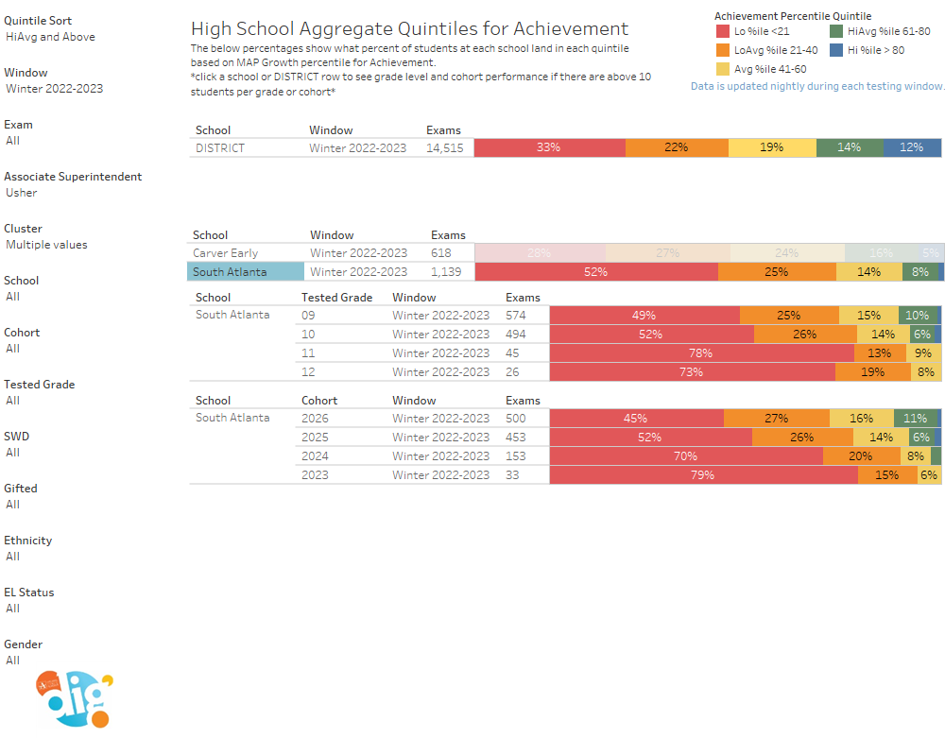

Slide 14

GO Team Discussion:
Data Protocol
What do you notice?
What are your wonderings?
What additional questions do you have?

Slide 15

Strategic planning will help you fully uncover your available options, set priorities for them, and define the methods to achieve them.
Robert J. Mckain

Slide 16
45 Day Check-in

Slide 17
Agenda
CIP-45 Day Check-in
ACES Presentation
School Strategic Plan
Discussion on Strategic Plan and progress
Updates for Strategic Plan (as necessary)

Slide 18
Quarterly CIP Check-in
As part of the Continuous Improvement process, all APS schools are completing a quarterly check-in for the Continuous Improvement Plans.
Questions to Consider
Based on our year long CIP plan, what are the actions that the school has already completed?​
What data supports the completion of an action step and success criteria (both implementation and student achievement)?

Slide 19
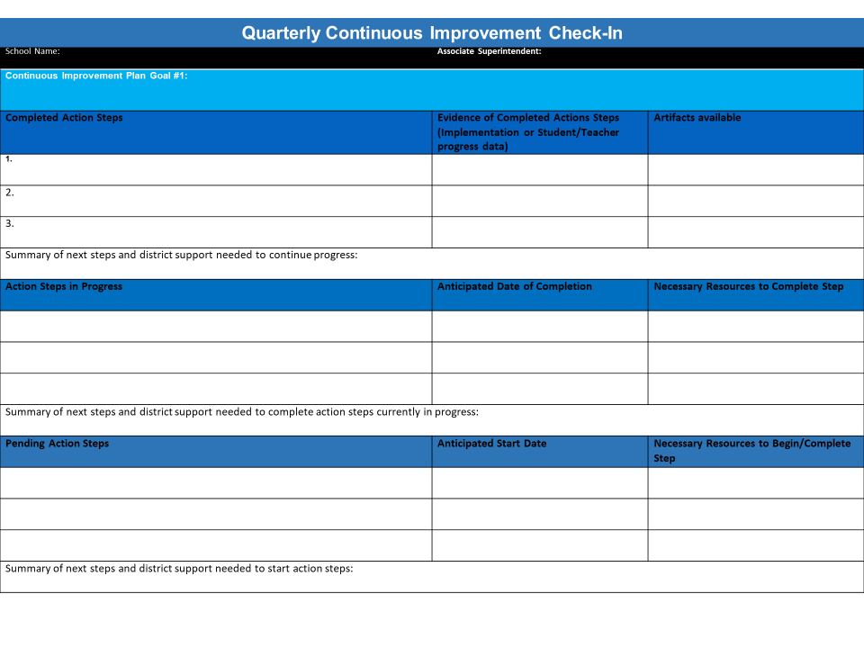

Slide 20

Accountability
Collaboration
Equity
Support
NOTE to Principal: Please insert your ACES presentation after this slide.
Fall 2022 ACES Presentation

Slide 21
12 years
1
12 years
2
STEAM
Cognia Certified (Whole School)
Cognia (2022) / GA (2024)
Purpose and Governance (All) AND Culture and Environment (All)
32 students
931
151 students
881
39 students
+39

Slide 22
Indicator | Time Frame
 | September 2021 | September 2022
Attendance Take Rate | 98.9 | 96.7
ADA Attendance Rate | 82.6 | 83.8
Students not chronically absent | 53.5 51.1
1.78
Subgroup | Total number of students | OSS Suspension Rate
Female | 472 | 1.39
Male | 463 | 2
SWD | 153 | 3.38
Black | 853 | 1.78
Hispanic | 71 | 0.59
Multi-race | N/A (<10)
White | N/A (<10)
Asian | N/A (<10)
*As of xx/xx/2022

Slide 23
 | Course Failures
 |  | 0 | 1 | 2 | 3+
 | ADA> 93% | 102 (11.4%) | 47 (5.2%) | 16 (1.8%) | 15 (1.7%)
 | ADA 86% - 93% | 89 (9.9%) | 82 (9.1%) | 38 (4.2%) | 49 (5.5%)
 | ADA <86% | 61 (6.8%) | 79 (8.8%) | 90 (10%) | 230 (25.6%)
Cohort | N Enrolled in expected grade level | Total Enrolled | % Enrolled in expected grade level
2023 | 185 | 204 | 91%
2024 | 155 | 220 | 70%
2025 | 211 | 250 | 84%
2026 | 252 | 253 | 99%
Average Daily Attendance
Program | Participation Rate (%)
 | Cohort 2022 | Cohort 2023
WBL | 7% | 0%
CTAE | 77% | 82%
Dual Enrollment | 5% | 3%
AP | 36% | 31%
IB | N/A | N/A
*As of 09/01/2022
Notes:
C

Slide 24
 | CIP Strategy | Action Step Progress Update
ELA | Implement rigorous and culturally relevant and linguistically responsive curriculum with fidelity in all core content areas and instructional best practices in Tier 1 instruction. | High Leverage Action Step: Weekly Data Meetings - Use of All in Learning Platform Lesson Internalization - Practice/Model/Real Time Feedback Goal Setting
Math | Implement rigorous and culturally relevant and linguistically responsive curriculum with fidelity in all core content areas and instructional best practices in Tier 1 instruction. | High Leverage Action Step: Weekly Data Meetings - Use of All in Learning Platform Lesson Internalization - Practice/Model/Real Time Feedback Goal Setting
Whole Child & Student Support | Implement district supported SEL curriculum with fidelity. Train all teachers in the use of the 7 Mindsets Curriculum. | High Leverage Action Step: Monthly overviews of SEL expectations in the classroom. Currently leading the district with implementation of 7 Mindsets Curriculum
Family Engagement | Schedule parent/family engagement meetings and workshops regarding curriculum expectations and instructional practices taking place for all scholars. | High Leverage Action Step- Monthly Parent Teacher Contact/Conference Days Principal Power Hour Meetings (Bi-Monthly)

Slide 27
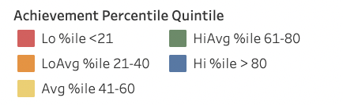
Notes:
Small group/REP classes in 9th grade Lit & Algebra I

Slide 28
Strategic Plan Progress

Slide 29
South Atlanta High School (South Atlanta Cluster)
District Mission & Vision
Cluster Mission & Vision
School Mission & Vision
With a caring culture of trust and collaboration, every student will graduate, ready for college and career
A high-performing school district where students love to learn, educators inspire, families engage and the community trusts the system
The South Atlanta Cluster will cultivate a universal culture of excellence through collaboration, academic achievement, personal responsibility, respect and a commitment to service.
Our vision is to be a high-performing cluster where every student graduates with college and career readiness
Work daily to change the mindset of who we are and what we can be.
A school that builds future leaders who will one day have a lasting impact in their communities and ultimately change the world.
Signature Program: STEM (Science, Technology, Engineering and Mathematics)
School Priorities
School Strategies
Key Performance Measures
Establish foundational core
content knowledge
Provide remediation and acceleration as indicated by data
Implement Science, Technology, Engineering, and Math (STEM) program model
Prepare all students to have essential life skills
Enhance college and career awareness and preparedness
1A. Use the district Unit's of study with fidelity & as an alignment tool for the expected level of rigor 1B. Ensure appropriate content-specific "Look-fors" are present in each classroom 1C. Ensure the standards-based learning environment to provide all students equal access to content 1D. Utilize an increase in technology on a daily basis 1E. Ensure students complete learning contracts 2A. Provide double-doses of math 2B. Provide ELA support by implementing target reading programs 2C. Offer after-school tutorial and mentors 2D. Provide an alternate bell schedule to offer remediation 3A. Implement STEM instruction and content 3B. Implement integrated, project- and problem-based learning projects 3C. Implement rigorous and real-world inter-disciplinary projects and units 3D. Integrate technology throughout the curriculum 4A. Implement Social and Emotional Learning (SEL) 4B. Increase the communication skills of all students 5A. Partnered with organization to provide ACT and SAT preparation 5B. Provide a credit recovery program 5C. Offer career pathways
6A. Improve the retention of high-quality teachers 7A. Provide targeted professional learning opportunities to improve the quality of instruction 7B. Implement intentional vertical and horizontal alignment and collaboration 7C. Implement on-going STEM specific professional learning opportunities 8A. Ensure consistent and ongoing feedback as part of the performance management process 8B. Identify and develop future school leaders through growth opportunities
9A. Develop relevant business and education partnerships and establish various effective strategies to enhance communication 9B. Ensure the necessary technology infrastructure and equipment is available in all schools 9C. Ensure the necessary resources to support STEM curriculum 9D. Ensure the required facilities, transportation, scheduling, and staffing allocations 10A. Analyze data to inform instruction 10B. Hold consistent PLC meetings to focus on student success
11A. Build community awareness, knowledge, and support for STEM 11B. Implement Adult Education opportunities 11C. Offer monthly parent workshops and curriculum nights 11D. Train staff on how to reach out to stakeholders 12A. Implement SEL for school staffs & parents 12B. Increase effective internal communications 12C. Build a strengths-based school community 12D. Implement attendance strategies
Increase the number of students in the Developing and Proficient categories on the Milestone in Algebra, Biology, U.S. History, and, American Lit
Increase Attendance Rate
Decrease Suspension Rate
Academic Program
Improve the recruitment and retention of high-quality teachers
Build Teacher Capacity
Expand school leadership development opportunities
Talent Management
Build systems and resources to support the School Strategic Plan
Identify and address the root causes to promote social and academic growth
Systems & Resources
Inform and engage the school community
Develop a positive, informed and engaged school culture
Culture

Slide 30
Activity & Discussion
Review the priorities and goals in your strategic plan and reflect on if the expected progress is being made. These guiding questions will help you determine what, if any, updates are needed for your school’s strategic plan.
Are all CIP Goals reflected in our Strategic Plan Priorities? If not, which CIP Goal(s) are missing and should be added to the Strategic Plan?
What progress has been made towards the priorities identified in our Strategic Plan? What evidence/data do we have?
Based upon available data, are there any other adjustments we need to make to the Strategic Plan?

Slide 31
Updates to the
Strategic Plan
Enter all changes/updates to your plan – be sure to include accountability measures, as appropriate.

Slide 32
Questions?
Wonderings?
Comments?

Slide 33
Preparing for
Budget Development

Slide 34
You are HERE
Fall 2021
GO Team Developed 2021-2025 Strategic Plan
1
Summer 2022
School Leadership completed Needs Assessment and defined overarching needs for SY22-23
2
August 2022
School Leadership completed 2022-2023 Continuous Improvement Plan
3
Sept. – Dec. 2022
Utilizing current data, the GO Team will review & update the school strategic priorities and plan, as needed
4
Before Winter Break
GO Team will take action (vote) on the school’s strategic plan and vote on the ranked strategic plan priorities for SY23-24 budget discussions.
5
1
2
3
4
5

Slide 35
Action on the Updated Strategic Plan
The GO Team needs to TAKE ACTION (vote) on its updated Strategic Plan. After the motion and a second, the GO Team may have additional discussion. Once discussion is concluded, the GO Team will vote.

Slide 36
Discussion
Strategic Plan Priority Ranking
In preparation for the 2023-2024 Budget Development (January–March 2023), the GO Team needs to rank its Strategic Plan Priorities. Use the next slide to capture the priority ranking.

Slide 37
Strategic Plan
Priority Ranking
Insert the school’s priorities from Higher to Lower
Higher
Lower

Slide 38
Action on the Strategic Plan Priorities
The GO Team needs to TAKE ACTION (vote) on its ranked Strategic Plan Priorities. After the motion and a second, the GO Team may have additional discussion. Once discussion is concluded, the GO Team will vote.

Slide 39


Where we’re going
At our next meeting(s) we will begin the discussion of the 2023-2024 budget.
Let me or the Chair know of any additional information you need for our future discussion.

Slide 40
Thank you

